Slide 1



Saving And Unsaving Concepts For Associated Registers, Circular Buffer, Broadcasting
Proprietary and Confidential

Slide 2
CONTENTS
Saving Concepts For Associated Register
‘C’ Runtime Environment
Unsaving Concepts For Associated Register
Circular Buffer
Broadcasting
Proprietary and Confidential

Slide 3
Saving Concepts For Associated Register
Wherever compiler call C run-time environment to ASM language ensure that these registers have same value upon function for all register and instruction set of corruption from ASM to C runtime environment.
So that we need to C run-time environment specifies a set of registers whose contents must be saved and restored.

Slide 4
‘C’ Runtime Environment
Conventions to be followed:
Dedicated Registers
Usage of Preserved Registers
Scratch Registers
Stack Registers
Proprietary and Confidential

Slide 5
Dedicated Registers
The C/C++ run-time environment specifies a set of registers whose contents should not be changed except in specific defined circumstances.
Proprietary and Confidential

Slide 6
Reserved Registers
The call-reserved registers must be saved and restored if they are modified within the assembly function.
Base Registers:
b0, b1, b2, b3, b5, b8, b9, b10, b11, b14, b15,
Index Registers:
i0, i1, i2, i3, i5, i8, i9, i10, i11, i14, i15
mode1, mode2
Modifier Register:
m0, m1, m2, m3, m8, m9, m10, m11
Data Registers:
r3,r5, r6, r7, r9, r10, r11, r13, r14, r15
ustat1, ustat2

Slide 7
Scratch Registers
The contents of these registers are not preserved across function calls, (Scratch Register)it does not need to save and restore the register.
Base Register
b4, b12, b13
Index Register and Modifier
i4, i12, m4, m12, i13
Data Register
r0, r1, r2, r4, r8, r12
Proprietary and Confidential

Slide 8
Stack Registers
C run-time environment reserves a set of registers for controlling the run-time stack.
These registers should not be utilised and are classified as reserved
i7 Stack pointer
i6 Frame pointer
Proprietary and Confidential

Slide 9
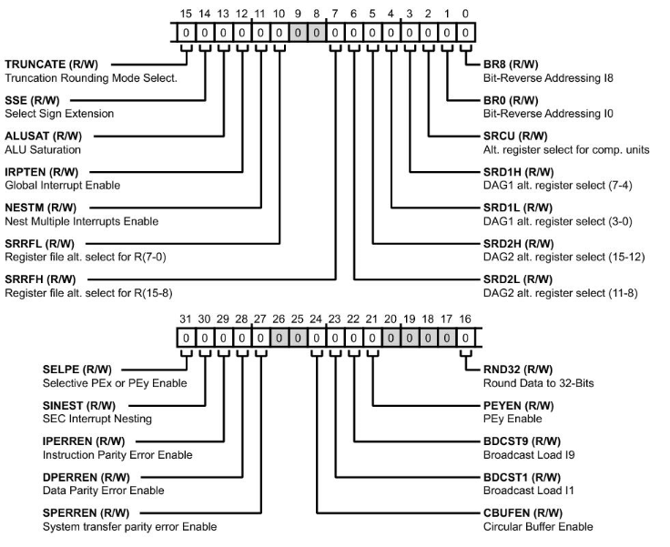
MODE1 Stack Register
It is possible to read and write the MODE1 register value in the top entry of the status stack through MODE1STK register.

Slide 10
MODE OF OPERATION
S.No | MODE OF OPERATION | MODE1 BIT | MACRO USED | FUNCTIONALITY
1 | Circular buffering | Bit 24 | CBUFEN | Enables (if 1) or disables (if 0) circular buffering
2 | Broadcast register | Bit 23 | BDCST1 (DAG1) | Enables register broadcast loads to complementary registers from I1 or I9 indexed moves (if 1) or disables broadcast loads (if 0).
3 |  | Bit 22 | BDCST9 (dag2)
4 | SIMD mode | Bit 21 | PEYEN or SIMD | Enables computations in PEy—SIMD mode—(if 1) or disables PEy—SISD mode—(if 0).

Slide 11
Circular Buffer in ASM
Supports addressing a data buffer at any address with predefined boundaries, wrapping around to cycle through this buffer repeatedly in a circular pattern.
Enable circular buffering (BIT SET MODE1 CBUFEN;). This operation is only needed once in a program
Load the buffer’s base address into the B register. This operation automatically loads the corresponding I register
Load the buffer’s length into the corresponding L register. For example, L0 corresponds to B0
Load the modify value (step size) into an M register in the corresponding DAG. For example, M0 through M7 correspond to B0. Alternatively, the program can use an immediate value for the modifier

Slide 12
Examples of Circular Buffer
LENGTH = 11
BASE ADDRESS = 0X55000
MODIFIER = 4
BIT SET MODE1 CBUFEN ; /* ENA BLES CIRCULAR BUFFER A DDRESSIN G; JUST ON CE IN PROG RA M */
B0 = 0X55000; /* LOADS B0 AND L0 REGISTERS WITH BASE ADDRESS */
L0 = 0XB; /* LOADS L0 REGISTER WITH LENGTH OF BUFFER */
M1 = 0X4; /* LOADS M1 WITH MODIFIER OR STEP SIZE */
LCNTR = 11, DO MY_CIR_BUFFER UNTIL LCE; /* SETS UP A LOOP CONTAINING BUFFER ACCESSES */
R0 = DM (I0,M1); /* AN ACCESS WITHIN THE BUFFER USES POST MODIFY ADDRESSING */
... /* OTHER INSTRUCTIONS IN THE MY_CIR_BUFFER LOOP */
MY_CIR_BUFFER: NOP; /* END OF MY_CIR_BUFFER LOOP */

Slide 13
Examples of Circular Buffer
Source buffer(i0)
Destination buffer(i1)
Base address –B0
1
1
2
4
l0 = 11
m1 = 3
3
7
4
10
5
r0 = dm(i0,m1)
dm(i1,m6) = r0
2
6
5
7
8
8
11
9
3
10
6
11
(0xA)
9
(0xA)

Slide 14
Broadcast registers:
Broadcast registers are used when there is usage of same register in the both processing elements at a time.
So we can say that, it can be used when the process is in SIMD mode.
When broadcast loading is enabled, the processor core writes to complementary registers in each processing element.
The BDCST1 and BDCST9 bits in the MODE1 register control broadcast register loading.
DAG1 register I1 (BDCST1) and DAG2 register I9 (BDCST9).

Slide 15
Broadcast MODE
Dual Processing Element Register Load Broadcasts
Instruction syntax | Rx = DM(I1,Ma); {Syntax #1} Rx = PM(I9,Mb); {Syntax #2} Rx = DM(I1,Ma), Rx = PM(I9,Mb); {Syntax #3}
PEx explicit operations | Rx = DM(I1,Ma); {Explicit #1} Rx = PM(I9,Mb); {Explicit #2} Rx = DM(I1,Ma), Rx = PM(I9,Mb); {Explicit #3}
PEy implicit operations | Sx = DM(I1,Ma); {Implicit #1} Sx = PM(I9,Mb); {Implicit #2} Sx = DM(I1,Ma), Sx = PM(I9,Mb); {Implicit #3}
1.Note that the letters a and b (as in Ma or Mb) indicate numbers for modify registers in DAG1 and DAG2. The letter a indicates a DAG1 register and can be replaced with 0 through 7. The letter b indicates a DAG2 register and can be replaced with 8 through 15.

Slide 16
QUESTIONS?
Proprietary and Confidential

